Slide 1
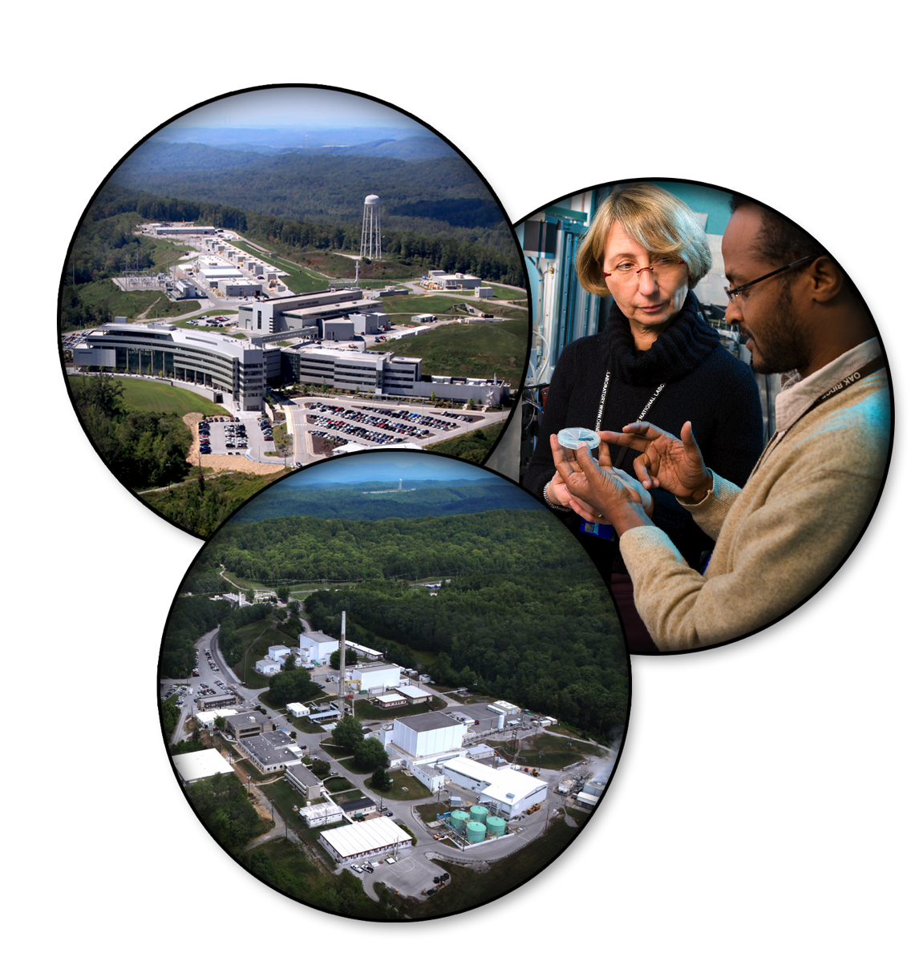
Event-Based Processing of Neutron Scattering Data
Peter Peterson, Janik Zikovsky, Stuart Campbell, Michael Reuter, Russell Taylor, and Nick Draper

